Slide 1
Freeciv
Meyer Montagner

Slide 2
Introduction
Single and multiplayer videogame
Turn-based strategy
Inspired by Sid Meier’s Civilization.
Desktop and Browser versions
Initial release: January 5th 1996
Stable release: July 22th 2018
Copyleft licence: GNU General Public Licence Version 2.

Slide 3
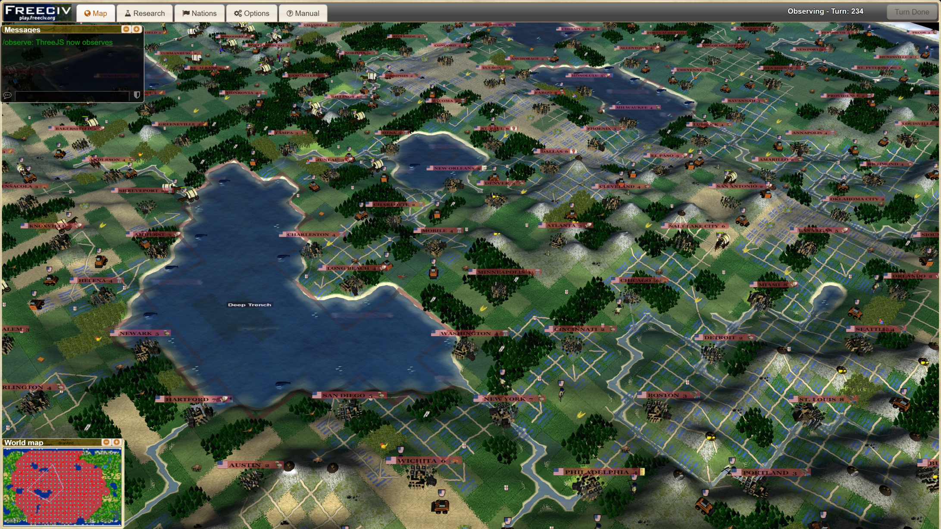

Slide 4
https://www.youtube.com/watch?v=jZsq9SADdQk

Slide 5
Objectives

